Slide 1
CS513 GEOSPATIAL VISION HW3
SATELLITE/AERIAL IMAGE RETRIEVAL
Group: Nikita Wali ,
Soundharya Sharma,
Srihari Gururaj

Slide 2
Outline
OVERVIEW
AIM
INTRODUCTION
Overview
Bit Maps Tile System
Tools required
Query a Aerial Image from Bitmap tile system
Generate bounding box of Aerial Image
Base tile, finest tile , Cropping
Result

Slide 3
OVERVIEW
We are given two points in geo coordinates.
Using these points the goal is to return the image bounded by these points with the finest resolution.
Use bitmap tile system to obtain the required highest resolution aerial image.

Slide 4
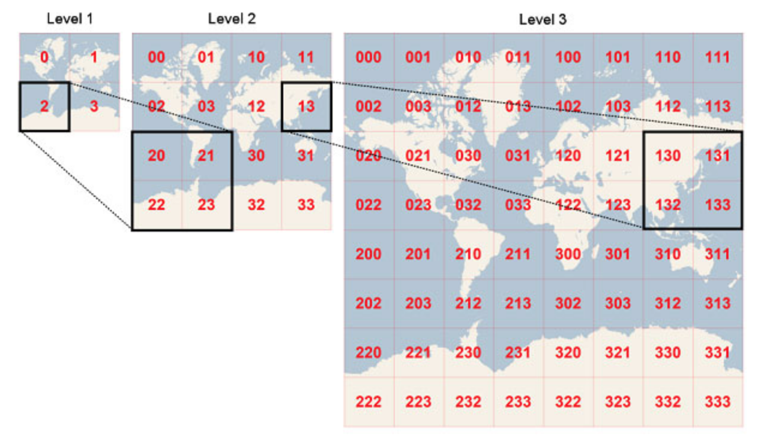
Bing Maps Tile System
Project the world map to a square number of pixels.
A bunch of pixels consist a tile orderly
As the level goes higher there are more pixels, more tiles so the resolution increases

Slide 5
Bing Maps Tile System
Tile System:
Each Level: L
Quadkey
Each Tile:
23-L levels
Each Tile
23 Levels
Tile Coordinates
Tile Coordinates

Slide 6
Tools We Used
Python 3.6
Package : Pillow
Bing Map Tile System

Slide 7
Query A Aerial Image from Bing Map Tile System
Apply For Bing Map license key:
Our key is: Al30EKo-GBnLPGUklNlRe9Np1b8akY7joyIA74skrj9LISIQv99uL3WEk_VLgvzM
Query from URL by quadkey:
http://ho.ortho.tiles.virtualearth.net/tiles/h#quadkey.jpeg?g=131&key=#license_key
#quadkey: can be generated by converting a pair of latitude and longitude.
#license_key: is our license key above.
Extract the socket and obtain the queried tile image.

Slide 8
Generate Bounding Box of Aerial Image
Base Tile:
Find the smallest tile which bounds everything of our bounding box
Inside the base tile, recursively find finest tiles.
Finest tiles:
From level 23 to lower levels, find the first non null tile.
Attach these tiles together to generate a “finest tile”.
Cropping:
Convert Longitudes and latitudes to pixel coordinates in the finest tile.
Crop the finest tile to the bounding box.

Slide 9
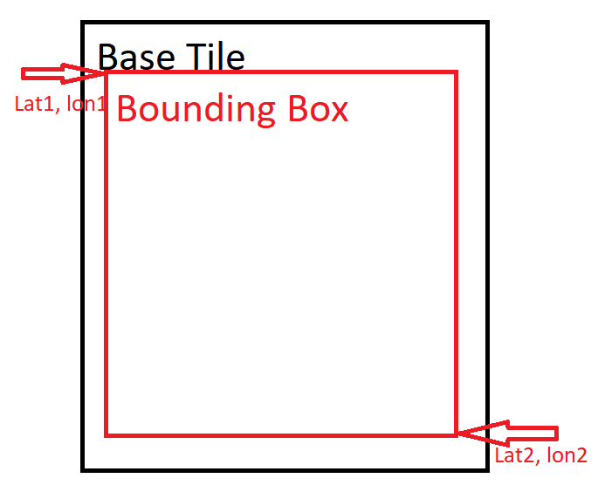

Base Tile
Input latitudes, longitudes: lat1, lon1, lat2, lon2
Convert inputs to tile coordinates: x1, y1, x2, y2
Search From level 23 to level 1
If $\left|x1−x2\right|≤1 and \left|y1−y2\right|≤1$
This tile level is the base tile level
Return the tile level and tile coordinate x1, y1

Slide 10
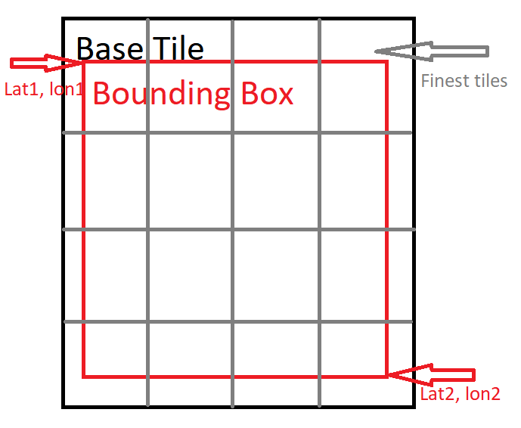
Finest Call
Input tile coordinates: x1, y1, x2, y2 and tile level.
From level 23 to base tile level:
If we can query all tile images in this level,
Return all tile images inside base tile.
Stitch these tile images together to generate finest tile image.
Return finest tile image.

Slide 11
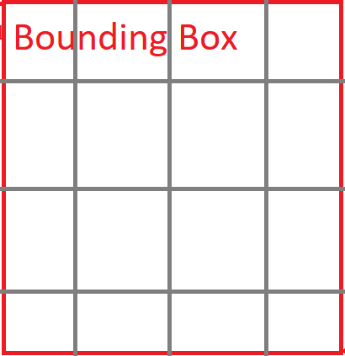
Cropping
Input: lat1, lon1, lat2, lon2 and finest tile image.
Convert latitudes and longitudes into pixel coordinates of finest tile.
Cropping finest tile image by the pixel coordinates to generate required bounding box of aerial image.
Return the bounding box image.

Slide 12
RESULT

